Slide 1



30 March 2015

Slide 2
Today’s agenda
PhD plan
Research Progress
Next Step
Project timetable
Admin matters
Next meeting

Slide 3
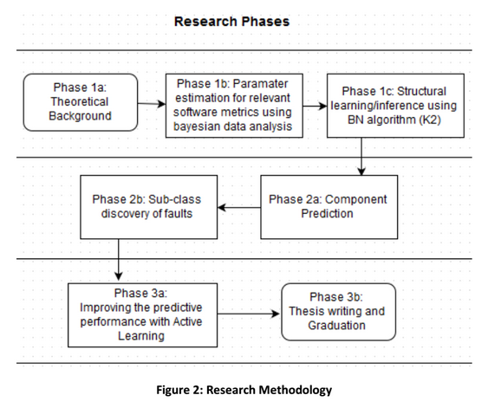
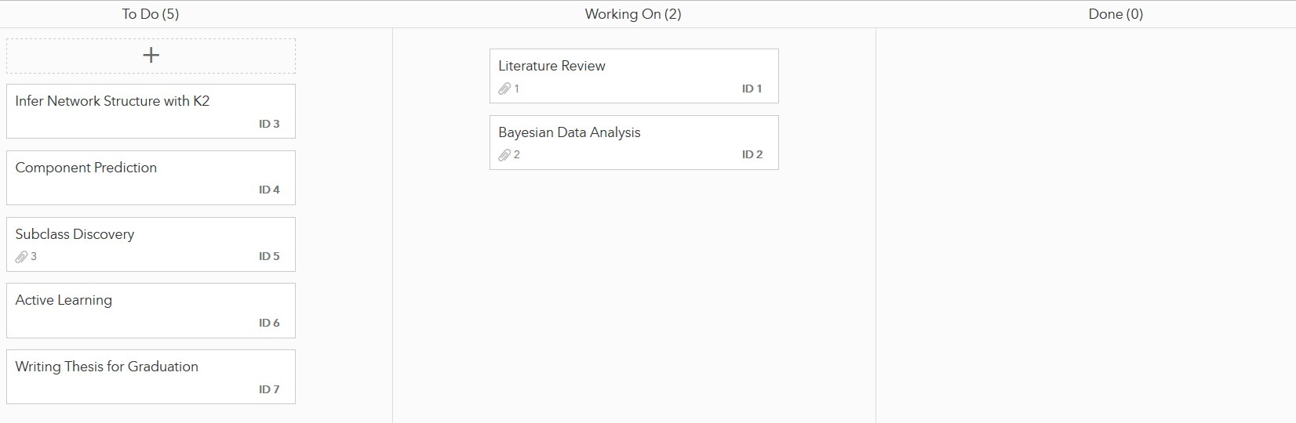
PhD plan -> Research Progress -> Next Step -> Project timetable -> Admin matters -> Next meeting

Slide 4
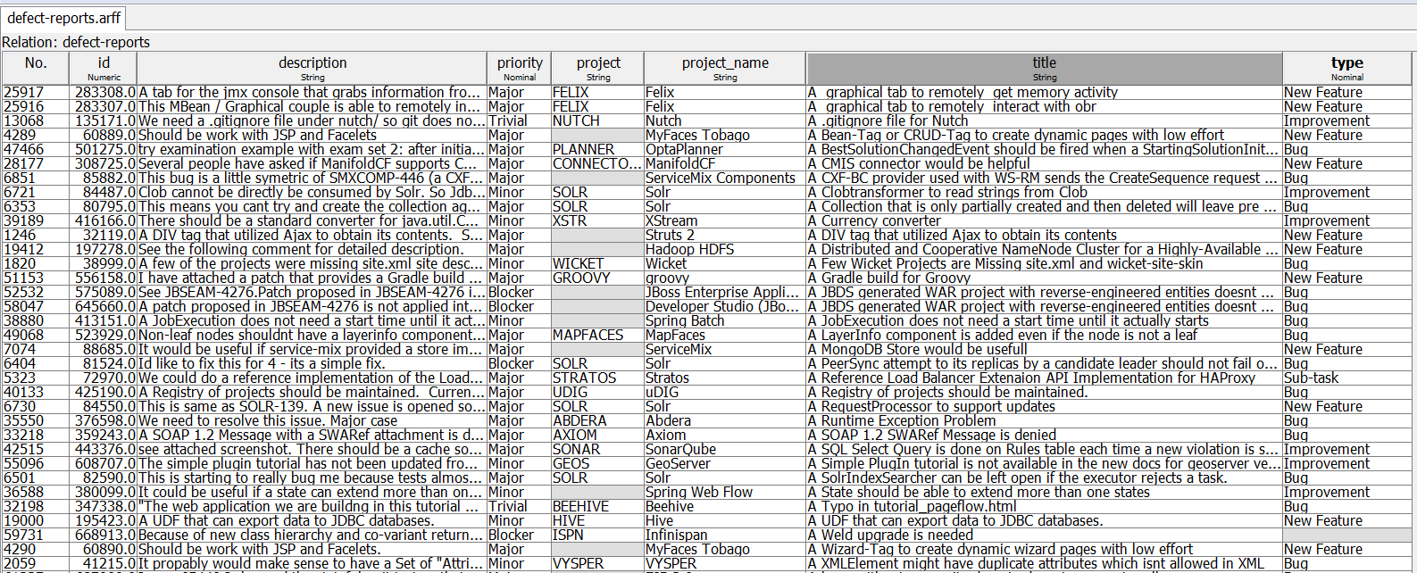

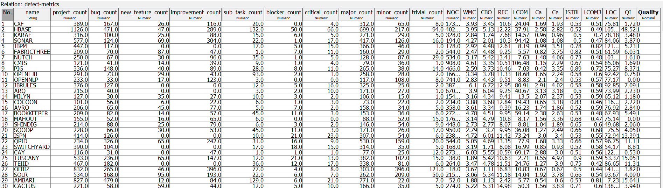
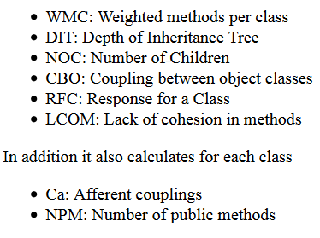
PhD plan -> Research Progress -> Next Step -> Project timetable -> Admin matters -> Next meeting
(bug_count / project_count) * (blocker_count + critical_count)
QI > 5 = 1 = risky
QI < 5 = 0 = safe

Slide 5
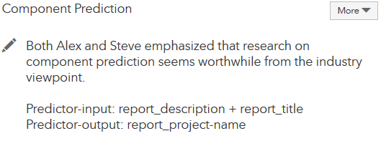
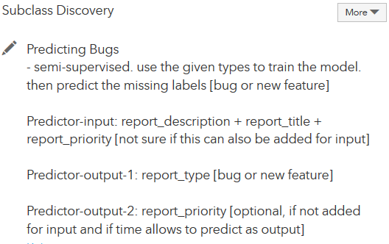
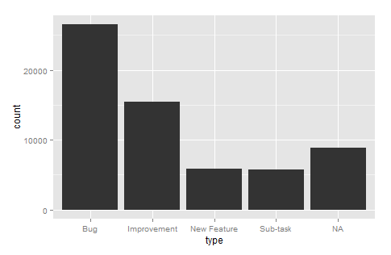
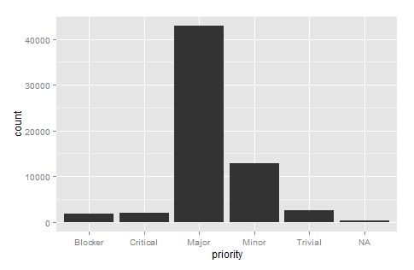
PhD plan -> Research Progress -> Next Step -> Project timetable -> Admin matters -> Next meeting

Slide 6
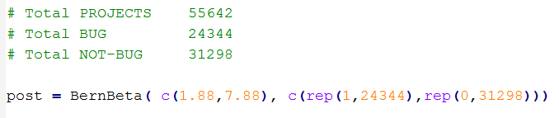
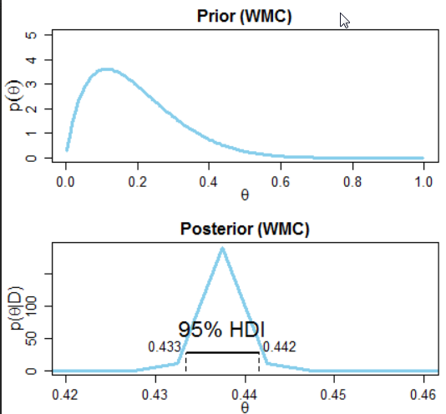
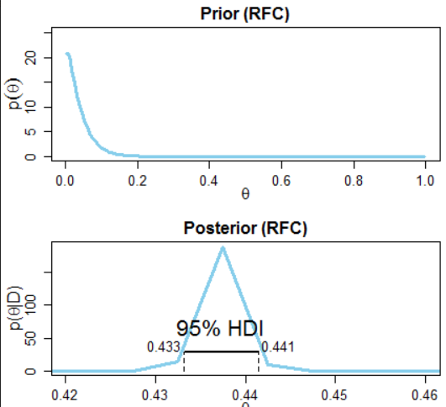
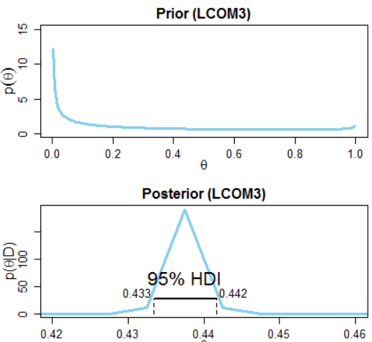
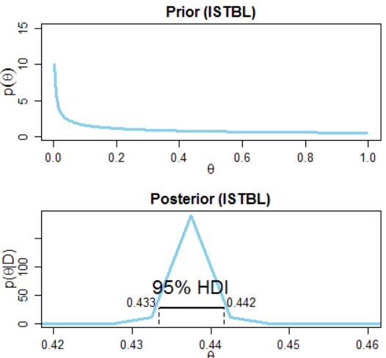
PhD plan -> Research Progress -> Next Step -> Project timetable -> Admin matters -> Next meeting

Slide 7
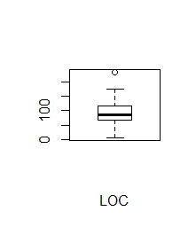
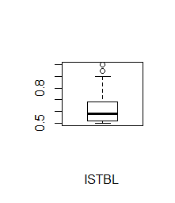
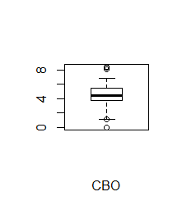
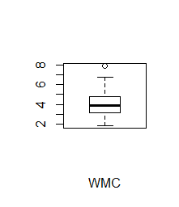
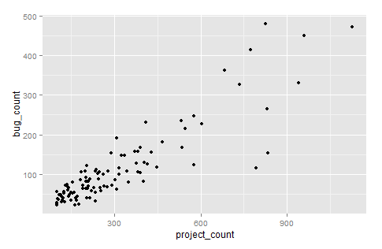
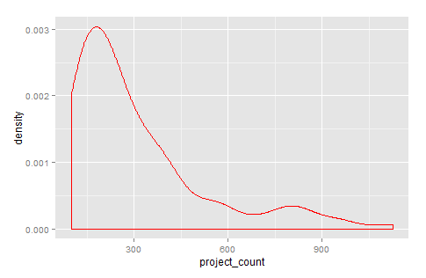
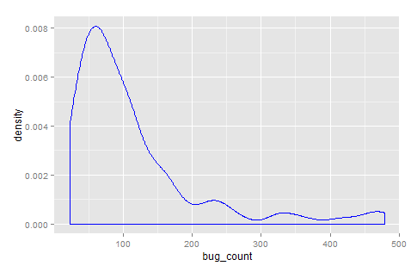
PhD plan -> Research Progress -> Next Step -> Project timetable -> Admin matters -> Next meeting
No of bugs increases with project size
Both pdfs are skewed to the right. Average issues reported per project are on a range of 150-250.

Slide 8
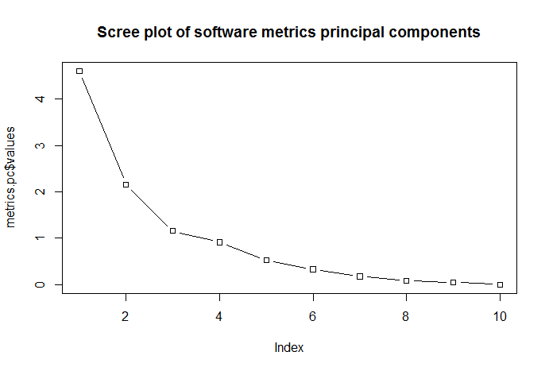
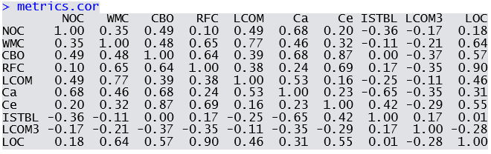
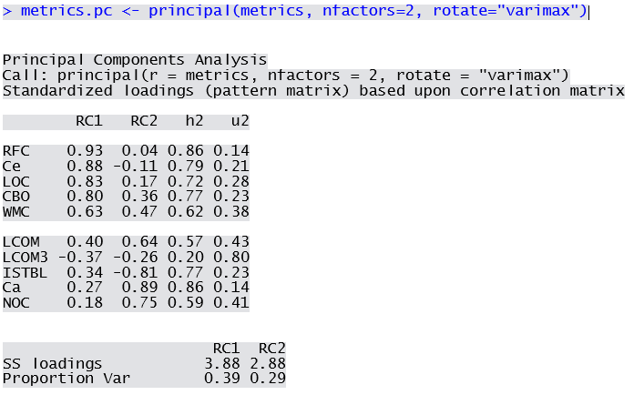
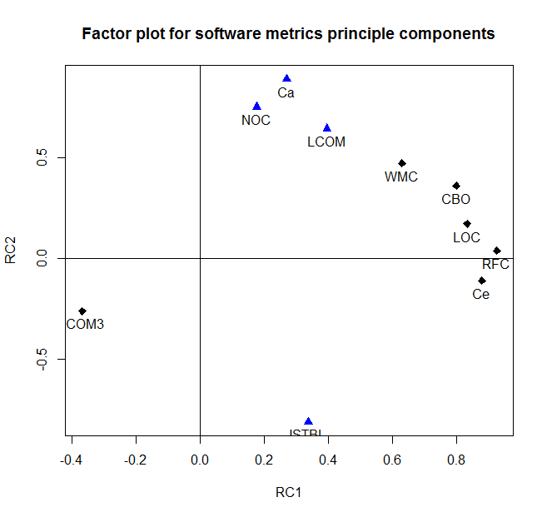
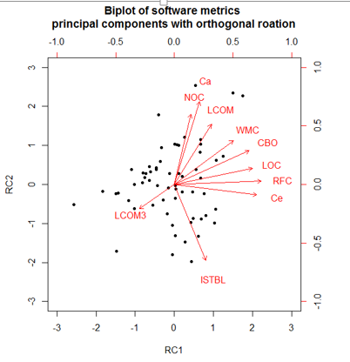
PhD plan -> Research Progress -> Next Step -> Project timetable -> Admin matters -> Next meeting
2 features/PC

Slide 9
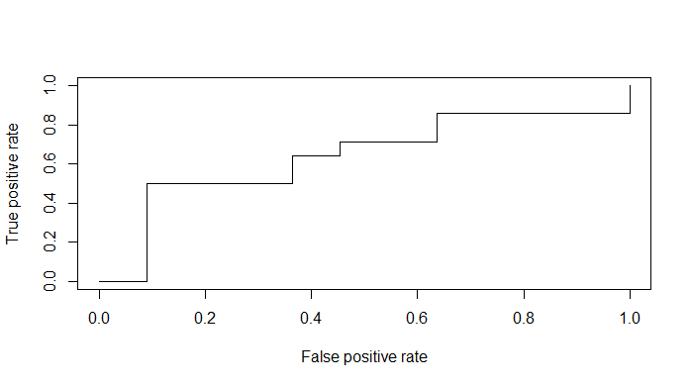
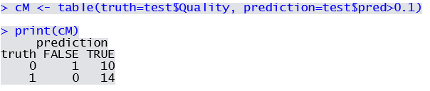

PhD plan -> Research Progress -> Next Step -> Project timetable -> Admin matters -> Next meeting
Zero type 2 error
Conclusion: metrics regression performance is 70% correct. with zero false negative or type 2 error at regression threshold 0.1.

Slide 10
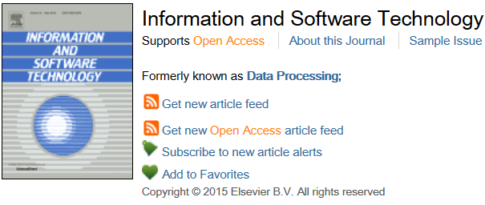
PhD plan -> Research Progress -> Next Step -> Project timetable -> Admin matters -> Next meeting
Continue data minning and model comparison with
DT, Näive Bayes, SVM (?), ensamble techniques
Summarize the findings and publish literature survey
Collect publication requirements
Preliminary selected IST for
publication target

Slide 11
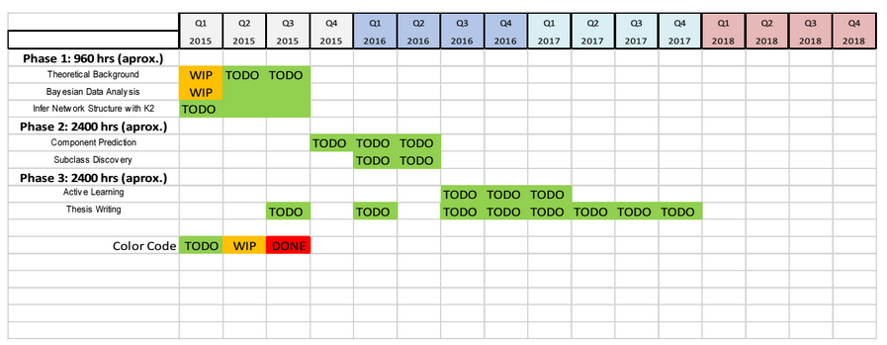
PhD plan -> Research Progress -> Next Step -> Project timetable -> Admin matters -> Next meeting
Project roadmap revesit

Slide 12
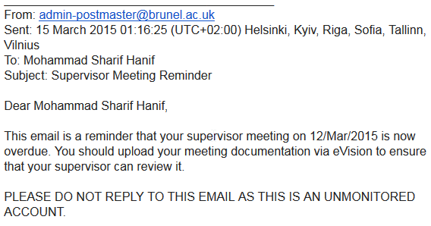
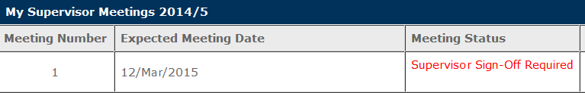
PhD plan -> Research Progress -> Next Step -> Project timetable -> Admin matters -> Next meeting
Project plan submitted
Following Supervisor Meeting Reminder received from

Slide 13
PhD plan -> Research Progress -> Next Step -> Project timetable -> Admin matters -> Next meeting
In 2-3 weeks
Result Expected:
Predictive permormance model comparison
First publication of lit-survey requirements collection started

